Slide 1

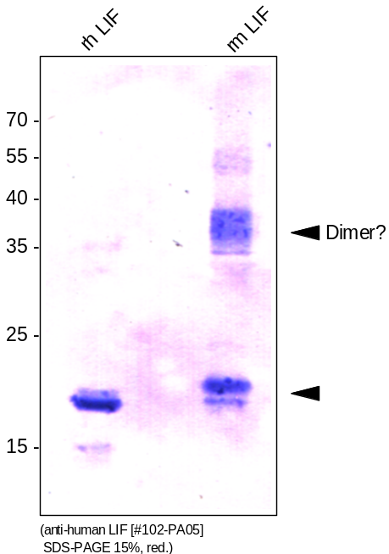
ReliaTech GmbH
Rabbit anti-human LIF
(Cat #102-PA05)
Figure 1: Western analysis of recombinant human / mouse Leukemia Inhibitory Factor (LIF) using a polyclonal antibody directed against a highly pure recombinant human LIF [Cat# 200-007]. There is a strong cross reactivity with the mouse LIF [Cat# M30-07] visible.
http://www.reliatech.de / orders@reliatech.de

